Slide 1
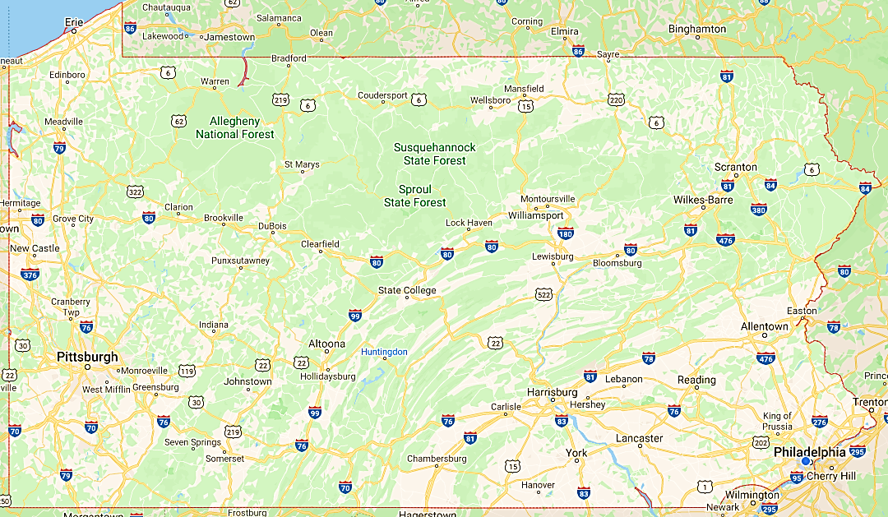
Building a model to predict level of car accident severity in Pennsylvania, USA

Slide 2
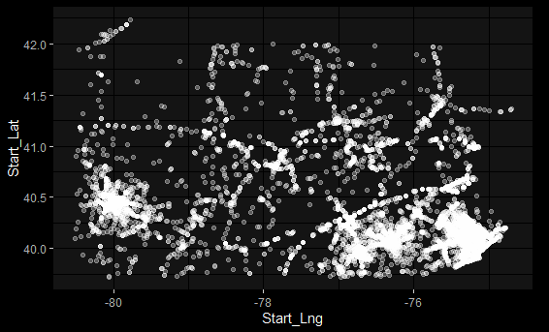
Dataset information
10,000 observations (accidents) in 2019 all over PA.

Slide 3
Dataset information
Response variable: Severity
4 levels (1,2,3,4) indicating traffic impact, not casualty
Explanatory variables: 48 variables
12 numeric: temperature, wind speed, humidity, distance, etc.
36 categorical: city, county, time period, indicators of amenities/facilities
Goal/Hopeful use of model: Find out items that contribute the most to severity, which can help in infrastructure planning/building

Slide 4
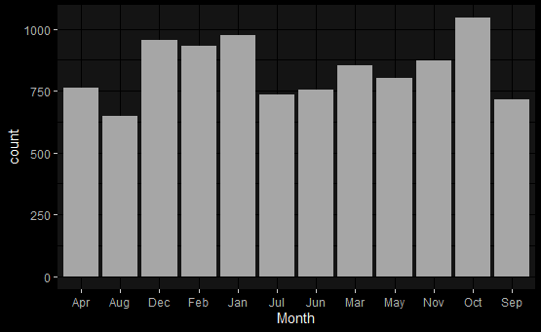
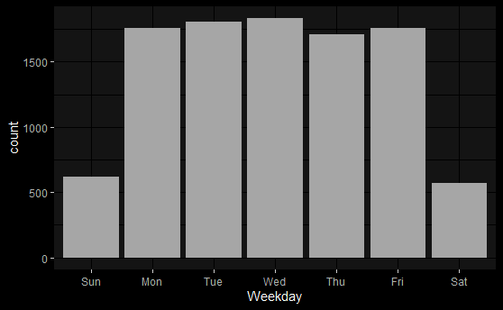
Data cleaning/manipulation
Break down Timestamp (e.g. 04/27/2019 18:20:30) into separate time variables

Slide 5
Data cleaning/manipulation
Check histograms/quantiles of numerical variables to detect extremes/unusuals
Cut off extremes using percentiles and some common sense
Log-transform some variables to solve skewness
Remove variables with too many missing values (> 90%)
Impute missing values based on median for numerical variables and mode for categorical variables

Slide 6
Model building
Quasi-randomly split dataset into training set and validation set.
Training set: 80%. Used for model building and imputation
Validation set: 20%. Used for model prediction assessment
Variable selection is based on Random Forest, due to limited laptop capacity
Model considerations:
Random Forest
Cumulative Logit Regression with Proportional Odds

Slide 7
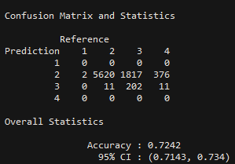
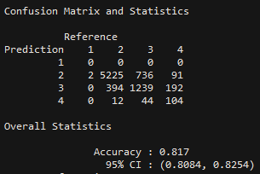
Model building and assessment
Random Forest:
Use 201 trees with mtry=5
Cumulative Logit with PO:

Slide 8
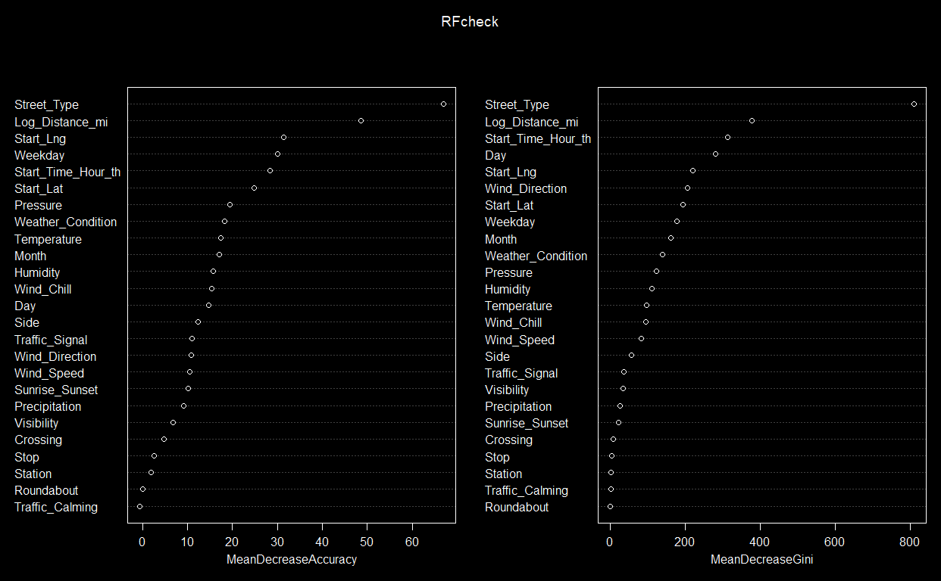
Model interpretation

Slide 9
Model interpretation
Some interesting parameter estimates:
Traffic_Calming: 1.905
→ Estimated odds of severity in lower levels rather than higher levels when there is traffic calming structure nearby is exp(1.905) = 6.72 times estimated odds if not, holding all others constant
Traffic_Signal: 0.991
→ Estimated odds of severity in lower levels rather than higher levels when there is traffic signal nearby is exp(0.991) = 2.69 times estimated odds if not, holding all others constant
Street_TypeHighway: -1.483
→ Estimated odds of severity in lower levels rather than higher levels when it takes place on an interstate highway instead of a road is exp(-1.483) = 0.227 times estimated odds otherwise, holding all others constant

Slide 10
Limitations/Challenges
Cannot check/detect all data validity/unusuals
Narrow down analysis to just PA in 2019
Original dataset has 3 millions observations, covering contiguous US 2016-2019
Cannot run proportional odds test
Measures to consolidate categorical variables are only applicable to binary response/simple logistic regression

Slide 11
Q&A

